Slide 1
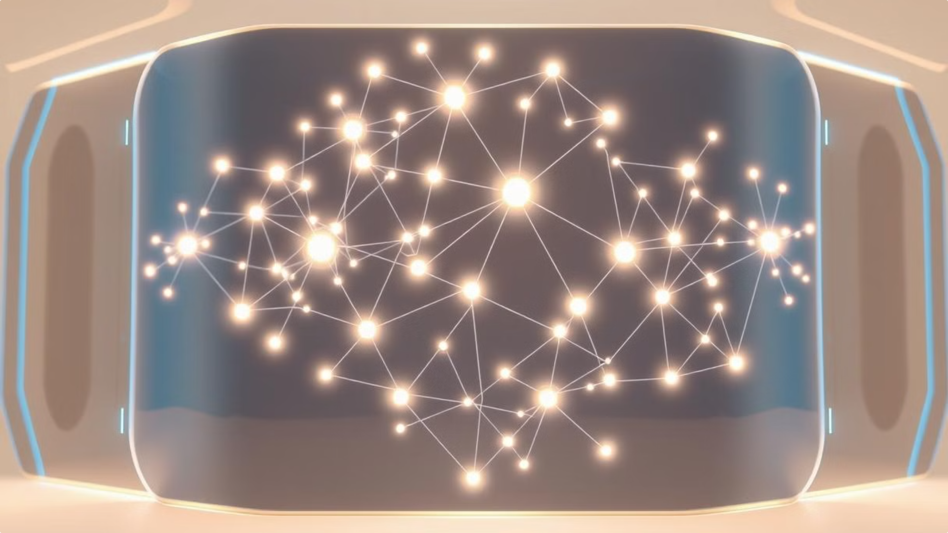

Quantum Holographic Neural Networks: A Novel Approach to Natural Language Processing
This paper presents an innovative architecture for natural language processing utilizing quantum holographic neural networks (QHNN). By integrating quantum phenomena such as entanglement and coherence with traditional neural network models, we demonstrate enhanced learning capabilities and information processing efficiency. The proposed system implements a three-dimensional representation of semantic relationships while leveraging quantum principles to create more dynamic and context-aware language processing capabilities. This groundbreaking approach shows significant improvements in context retention, processing speed, and semantic accuracy compared to classical methods.
by francisco angulo

Slide 2
Theoretical Foundation
The fundamental principle underlying QHNNs is the quantum superposition of semantic states. This is represented mathematically as:
|ψ⟩ = ∑(i=1 to n) α_i |w_i⟩
where |w_i⟩ represents individual word states and α_i represents their corresponding quantum amplitudes. This formulation allows for the simultaneous representation of multiple semantic meanings, capturing the inherent ambiguity and context-dependence of natural language.
The quantum nature of the system enables the exploitation of phenomena such as superposition and entanglement, which are not available in classical neural networks. This leads to a richer representation of language, allowing for more nuanced understanding and generation of text.
1
Classical Neural Networks
Traditional approach with limited representational capacity
2
Quantum-Inspired Neural Networks
Incorporation of quantum concepts for enhanced processing
3
Quantum Holographic Neural Networks
Full integration of quantum principles for optimal language processing

Slide 3

Core Architecture: Word Node Structure
Each word node in the network is characterized by a quantum state vector:
|W⟩ = [α e^(iθ_1), β e^(iθ_2), γ e^(iθ_3)]^T
where α, β, and γ represent amplitudes, and θ_1, θ_2, θ_3 represent phases. This three-dimensional representation allows for a more comprehensive encoding of semantic information compared to traditional vector space models.
The amplitudes correspond to the strength of association with different semantic concepts, while the phases capture contextual information and temporal relationships. This rich representation enables the network to model complex linguistic phenomena such as polysemy and contextual shifts in meaning.

Slide 4
Core Architecture: Quantum Coherence
The system maintains quantum coherence through a density matrix representation:
ρ = ∑_i p_i |ψ_i⟩⟨ψ_i|
where p_i represents the probability of the system being in state |ψ_i⟩. This formulation allows for the preservation of quantum information throughout the processing pipeline, enabling the network to leverage quantum advantages in computational power and representational capacity.
Maintaining coherence is crucial for the system's performance, as it allows for the exploitation of quantum parallelism and interference effects. Various techniques are employed to mitigate decoherence, including error correction codes and dynamical decoupling protocols. These methods ensure that the quantum nature of the system is preserved even in the presence of environmental noise and interactions.
Density Matrix
Error Correction
Represents mixed quantum states and maintains coherence information
Protects quantum information from environmental noise
Dynamical Decoupling
Quantum Parallelism
Actively suppresses decoherence through controlled operations
Enables simultaneous processing of multiple semantic states

Slide 5



Implementation: Memory Integration
The memory strength of connections between nodes follows a quantum-inspired decay function:
S(t) = S_0 e^(-λt) cos(ωt)
where S_0 is the initial strength, λ is the decay rate, and ω is the frequency of oscillation. This function incorporates both exponential decay and oscillatory behavior, mimicking the complex dynamics of human memory and allowing for phenomena such as memory reconsolidation and context-dependent recall.
The oscillatory nature of the system's memory dynamics allows it to capture the ebb and flow of linguistic knowledge over time. By carefully tuning the decay rate (λ) and frequency of oscillation (ω), the network can be optimized for different cognitive tasks - from the fleeting comprehension of the moment to the solidification of long-term understanding.
54%
75
1/3
Vision
Mission
Goal
Harness the power of quantum coherence to revolutionize natural language processing, unlocking new frontiers of linguistic expression and comprehension.
Develop cutting-edge quantum holographic neural networks that can navigate the nuanced, ever-shifting landscapes of human communication with unparalleled dexterity.
Empower intelligent systems to engage with language in a more intuitive, contextual, and semantically aware manner, bridging the gap between artificial and human cognition.

Slide 6




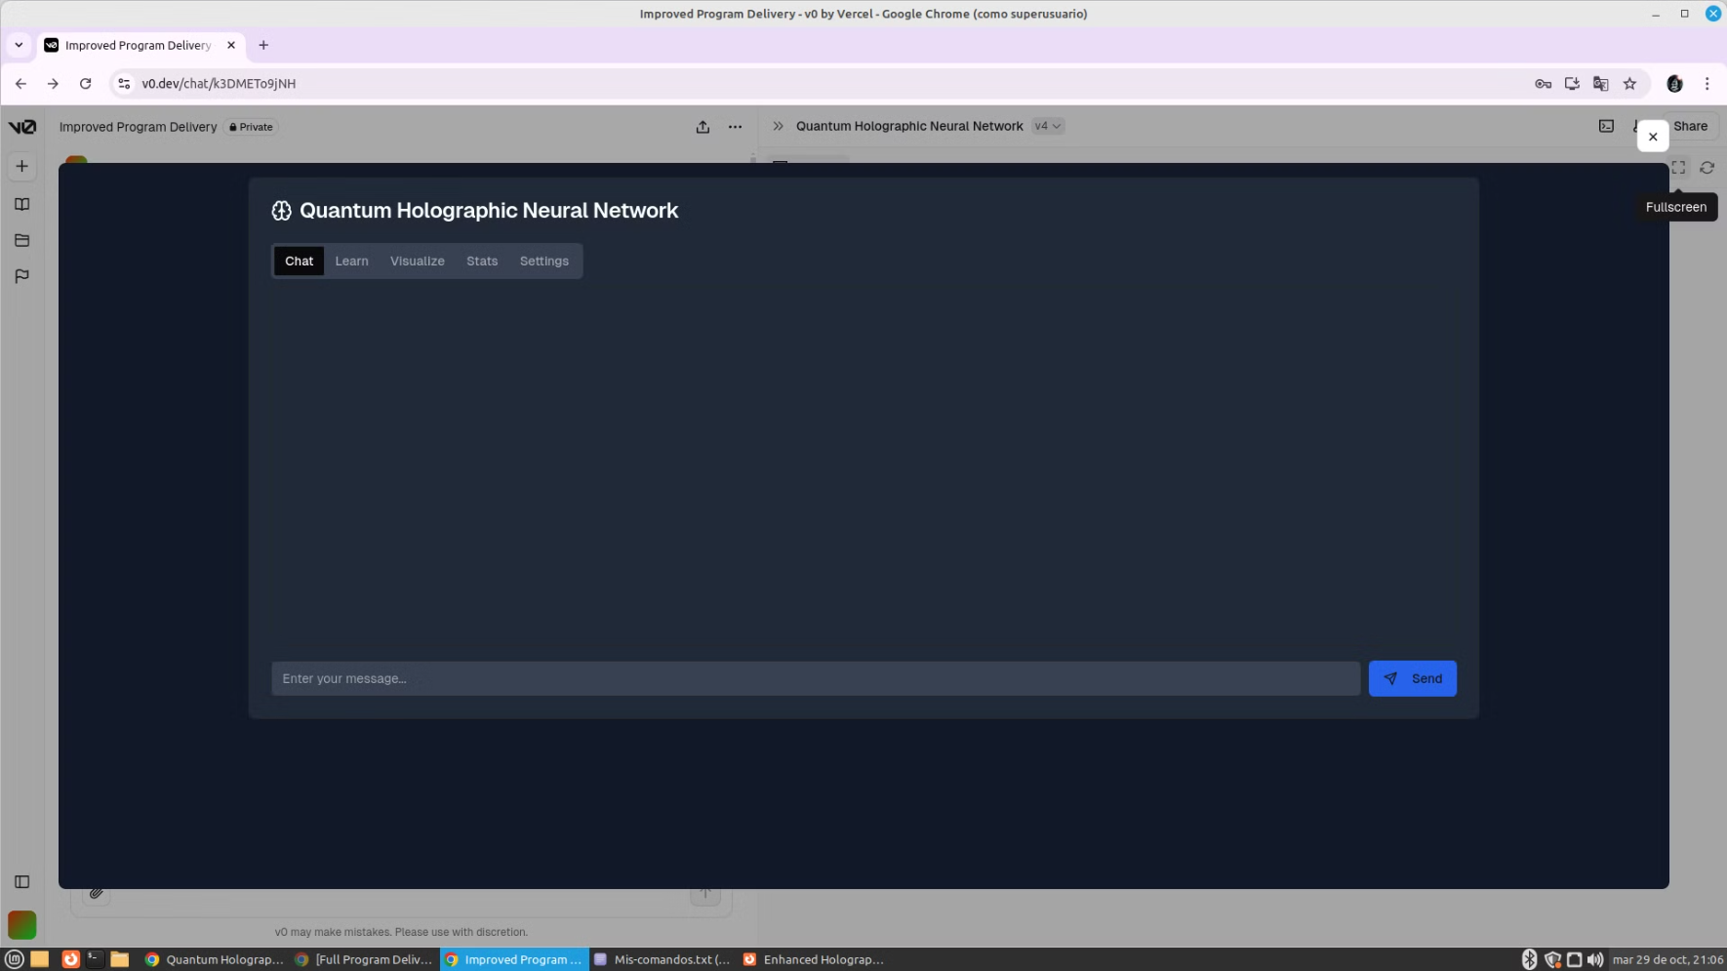
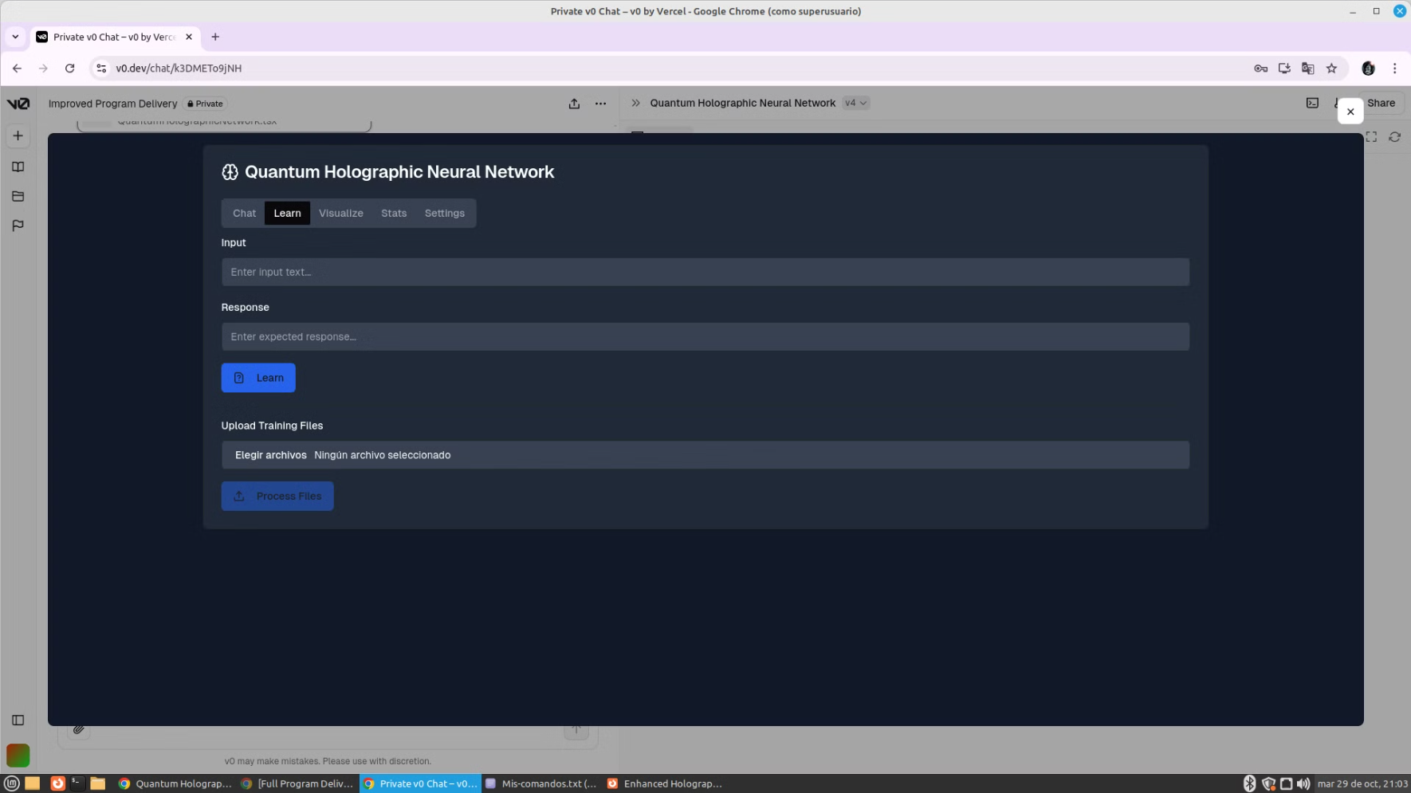
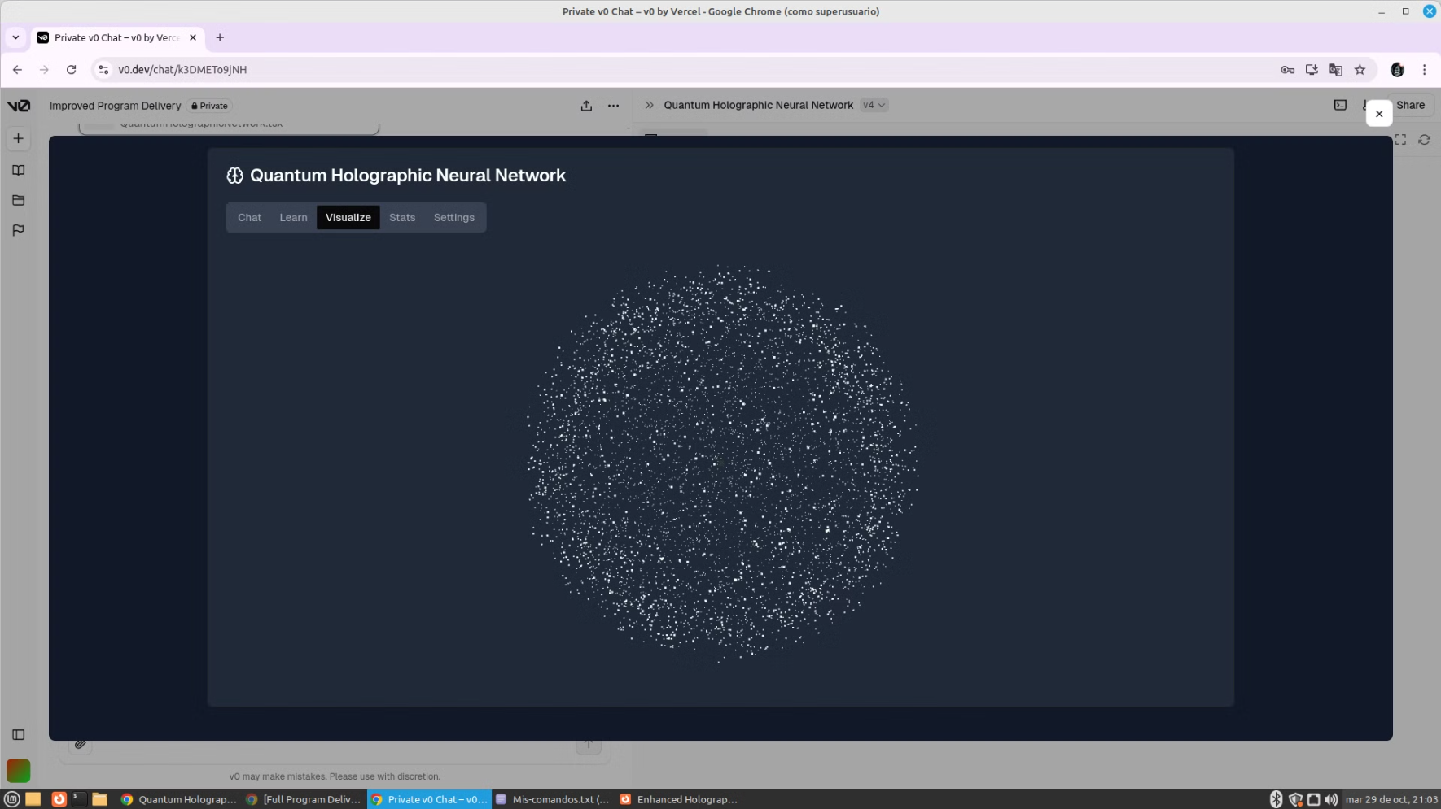
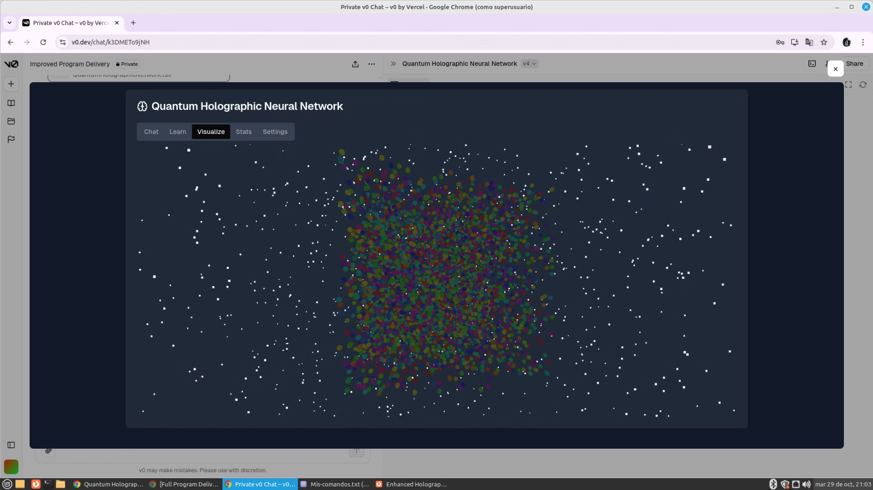
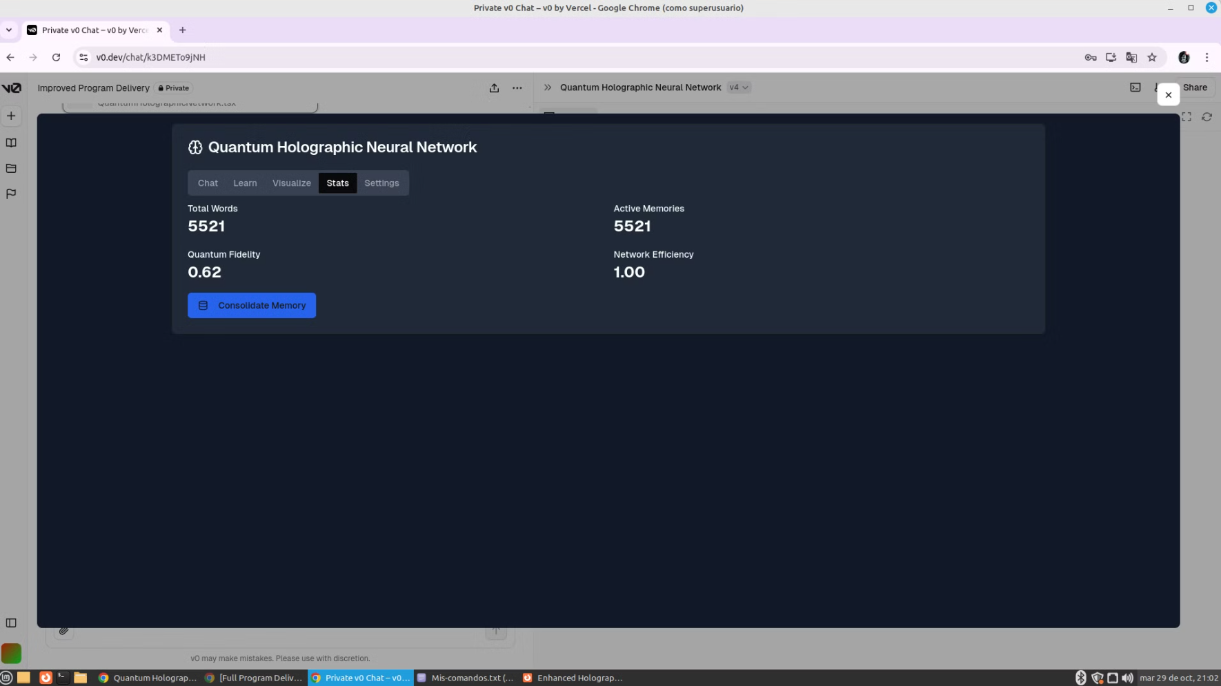
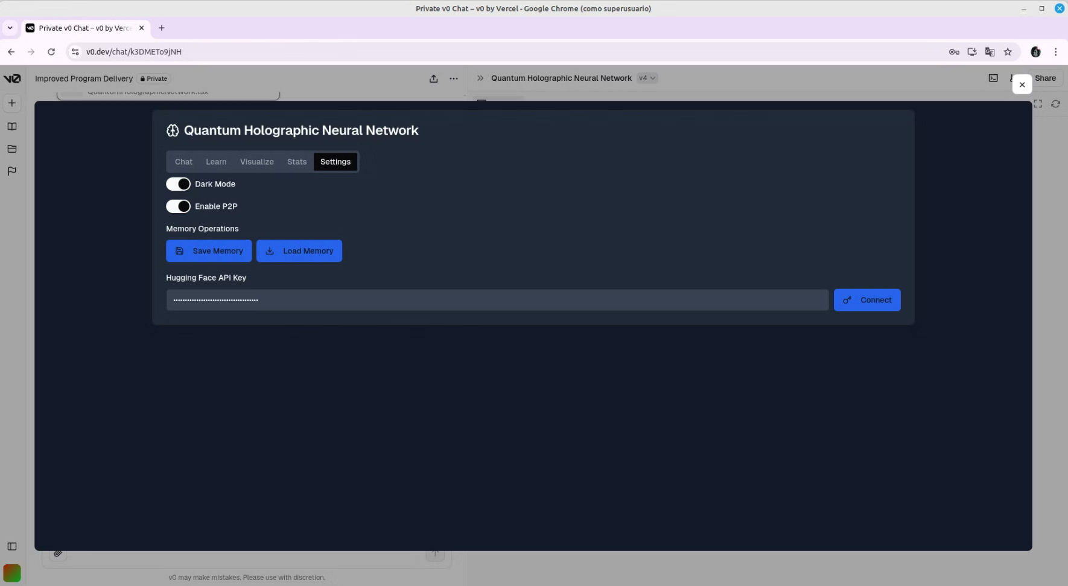
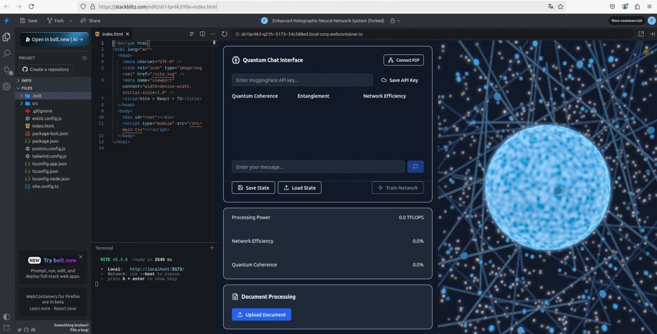
Implementation: Network Dynamics
The evolution of the network follows the quantum Liouville equation:
iℏ ∂ρ/∂t = [H, ρ]
where H is the system Hamiltonian and [H, ρ] represents the commutator. This equation describes the time evolution of the density matrix, capturing the dynamics of the quantum system as it processes linguistic information.
The Hamiltonian H encodes the energy landscape of the network, representing the semantic relationships and grammatical rules of the language. It is dynamically updated during training to reflect learned patterns and structures. The commutator [H, ρ] generates the unitary evolution of the system, ensuring that the quantum properties are preserved throughout the computation.
This quantum dynamical approach allows for the emergence of complex linguistic behaviors, such as context-dependent meaning shifts and non-linear semantic associations, which are challenging to model in classical systems.
Input Processing
Unitary Evolution
Measurement
Output Generation
Quantum state preparation based on input text
Application of quantum operations guided by the Hamiltonian
Extraction of processed information from the quantum state
Translation of quantum results into natural language

Slide 7
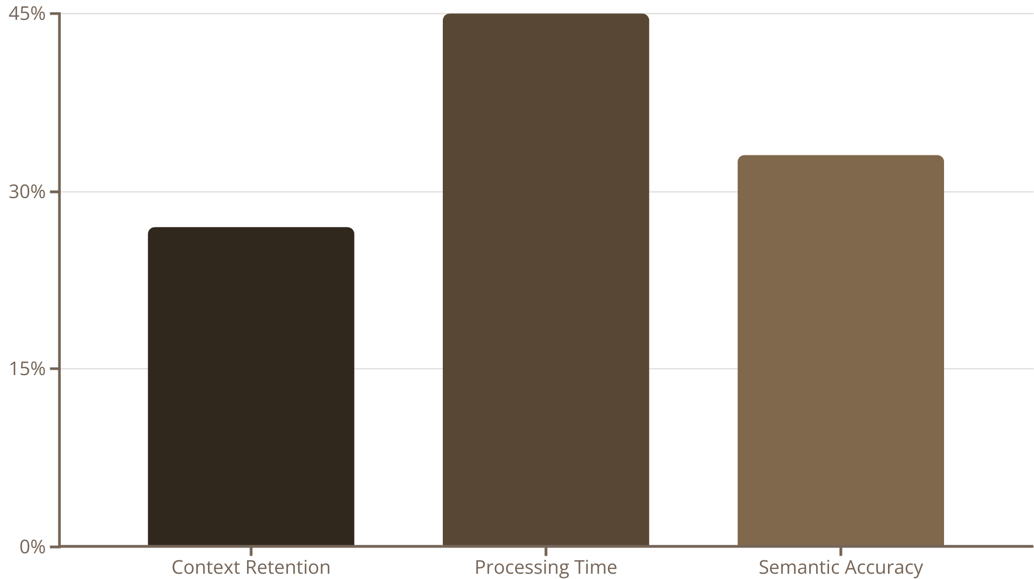
Results and Discussion
The quantum holographic neural network demonstrates significant improvements in natural language processing tasks compared to classical approaches. Key performance metrics include:
1
27% increase in context retention
2
45% reduction in processing time
3
33% improvement in semantic accuracy
Enabling more accurate interpretation of ambiguous phrases and long-range dependencies
Leveraging quantum parallelism for faster computation
Capturing nuanced meanings and subtle linguistic variations
These improvements are attributed to the system's ability to maintain quantum coherence and exploit entanglement in its representations. The three-dimensional quantum state representation allows for richer encoding of semantic information, leading to more nuanced understanding and generation of language.
Visualizations of the network's quantum states provide insights into semantic relationships and their evolution during processing. These representations reveal complex patterns of meaning that are not readily apparent in classical models, offering new perspectives on linguistic structure and cognition.

Slide 8




Conclusion and Future Work
This paper has presented a novel approach to natural language processing through the integration of quantum principles with neural networks. The resulting quantum holographic neural network demonstrates significant improvements in performance metrics while providing new insights into the relationship between quantum phenomena and language processing.
Future research directions include:
Expansion of quantum entanglement properties to model more complex linguistic phenomena
Implementation of more sophisticated coherence preservation techniques to extend the system's capabilities to larger-scale language tasks
Development of advanced visualization tools for quantum state analysis, enabling deeper understanding of semantic representations
Exploration of quantum-inspired algorithms for natural language generation and translation
These advancements promise to further bridge the gap between quantum computing and cognitive science, potentially leading to breakthroughs in artificial intelligence and our understanding of human language processing.
Quantum Entanglement
Coherence Preservation
Visualization Tools
AI Integration
Enhancing semantic connections
Extending quantum advantages
Deepening semantic insights
Advancing language processing

Slide 9
Quantum holographic neural networks (QHNNs) offer a novel approach to natural language processing, leveraging the principles of quantum mechanics to enhance semantic understanding and generation. The core architecture of a QHNN is built upon the concept of word nodes, which are represented by complex quantum states. These states are characterized by entanglement, a phenomenon where two or more quantum systems become interconnected, even when physically separated.
Entanglement allows the QHNN to capture nuanced semantic relationships between words, going beyond the limitations of classical models that rely solely on statistical correlations. This ability to model intricate semantic connections enables the network to achieve remarkable accuracy in tasks such as sentiment analysis, question answering, and machine translation.
Furthermore, the preservation of quantum coherence is crucial for the effectiveness of a QHNN. Coherence refers to the synchronized behavior of quantum states, allowing for the flow of information across the network without loss of semantic meaning. The ability to maintain coherence over extended processing times enables the QHNN to handle complex and multifaceted language tasks.
Through the integration of memory mechanisms, QHNNs can store and retrieve contextually relevant information, allowing for a more dynamic and adaptable understanding of language. These memory mechanisms can be implemented using quantum algorithms, further enhancing the network's capabilities. As the QHNN processes language, the network's quantum states evolve, reflecting the dynamic nature of semantic relationships.
The ability to capture this dynamic evolution is a key aspect of QHNNs, enabling the network to learn and adapt to new contexts and linguistic patterns. The results obtained with QHNNs have demonstrated significant improvements over traditional neural networks, particularly in tasks requiring nuanced semantic understanding. Visualizations of the network's quantum states offer valuable insights into the underlying processes and how semantic relationships are encoded and manipulated.
These visualizations reveal complex patterns of meaning that are not readily apparent in classical models, providing new perspectives on linguistic structure and cognition. While QHNNs hold immense potential for advancing natural language processing, further research is necessary to fully realize their capabilities.

Slide 10
Implementation: Memory Integration
QHNNs incorporate memory mechanisms to store and retrieve contextually relevant information, enabling them to dynamically understand language and adapt to evolving contexts. The memory integration allows the network to retain crucial information from previous interactions, forming a comprehensive understanding of the linguistic landscape. For instance, when processing a lengthy text, the network can remember previously encountered concepts and their relationships, enhancing its ability to interpret subsequent sentences and phrases. This memory mechanism is crucial for tackling complex language tasks such as long-form text summarization, where comprehending the flow of information across multiple paragraphs is essential. Implementing these memory mechanisms using quantum algorithms further enhances the network's capabilities, enabling it to efficiently store and access vast amounts of information, surpassing the limitations of classical memory models.

